Slide 1
The Life Of An Optimizely Developer
Graham Carr | 6th June 2024

Slide 2
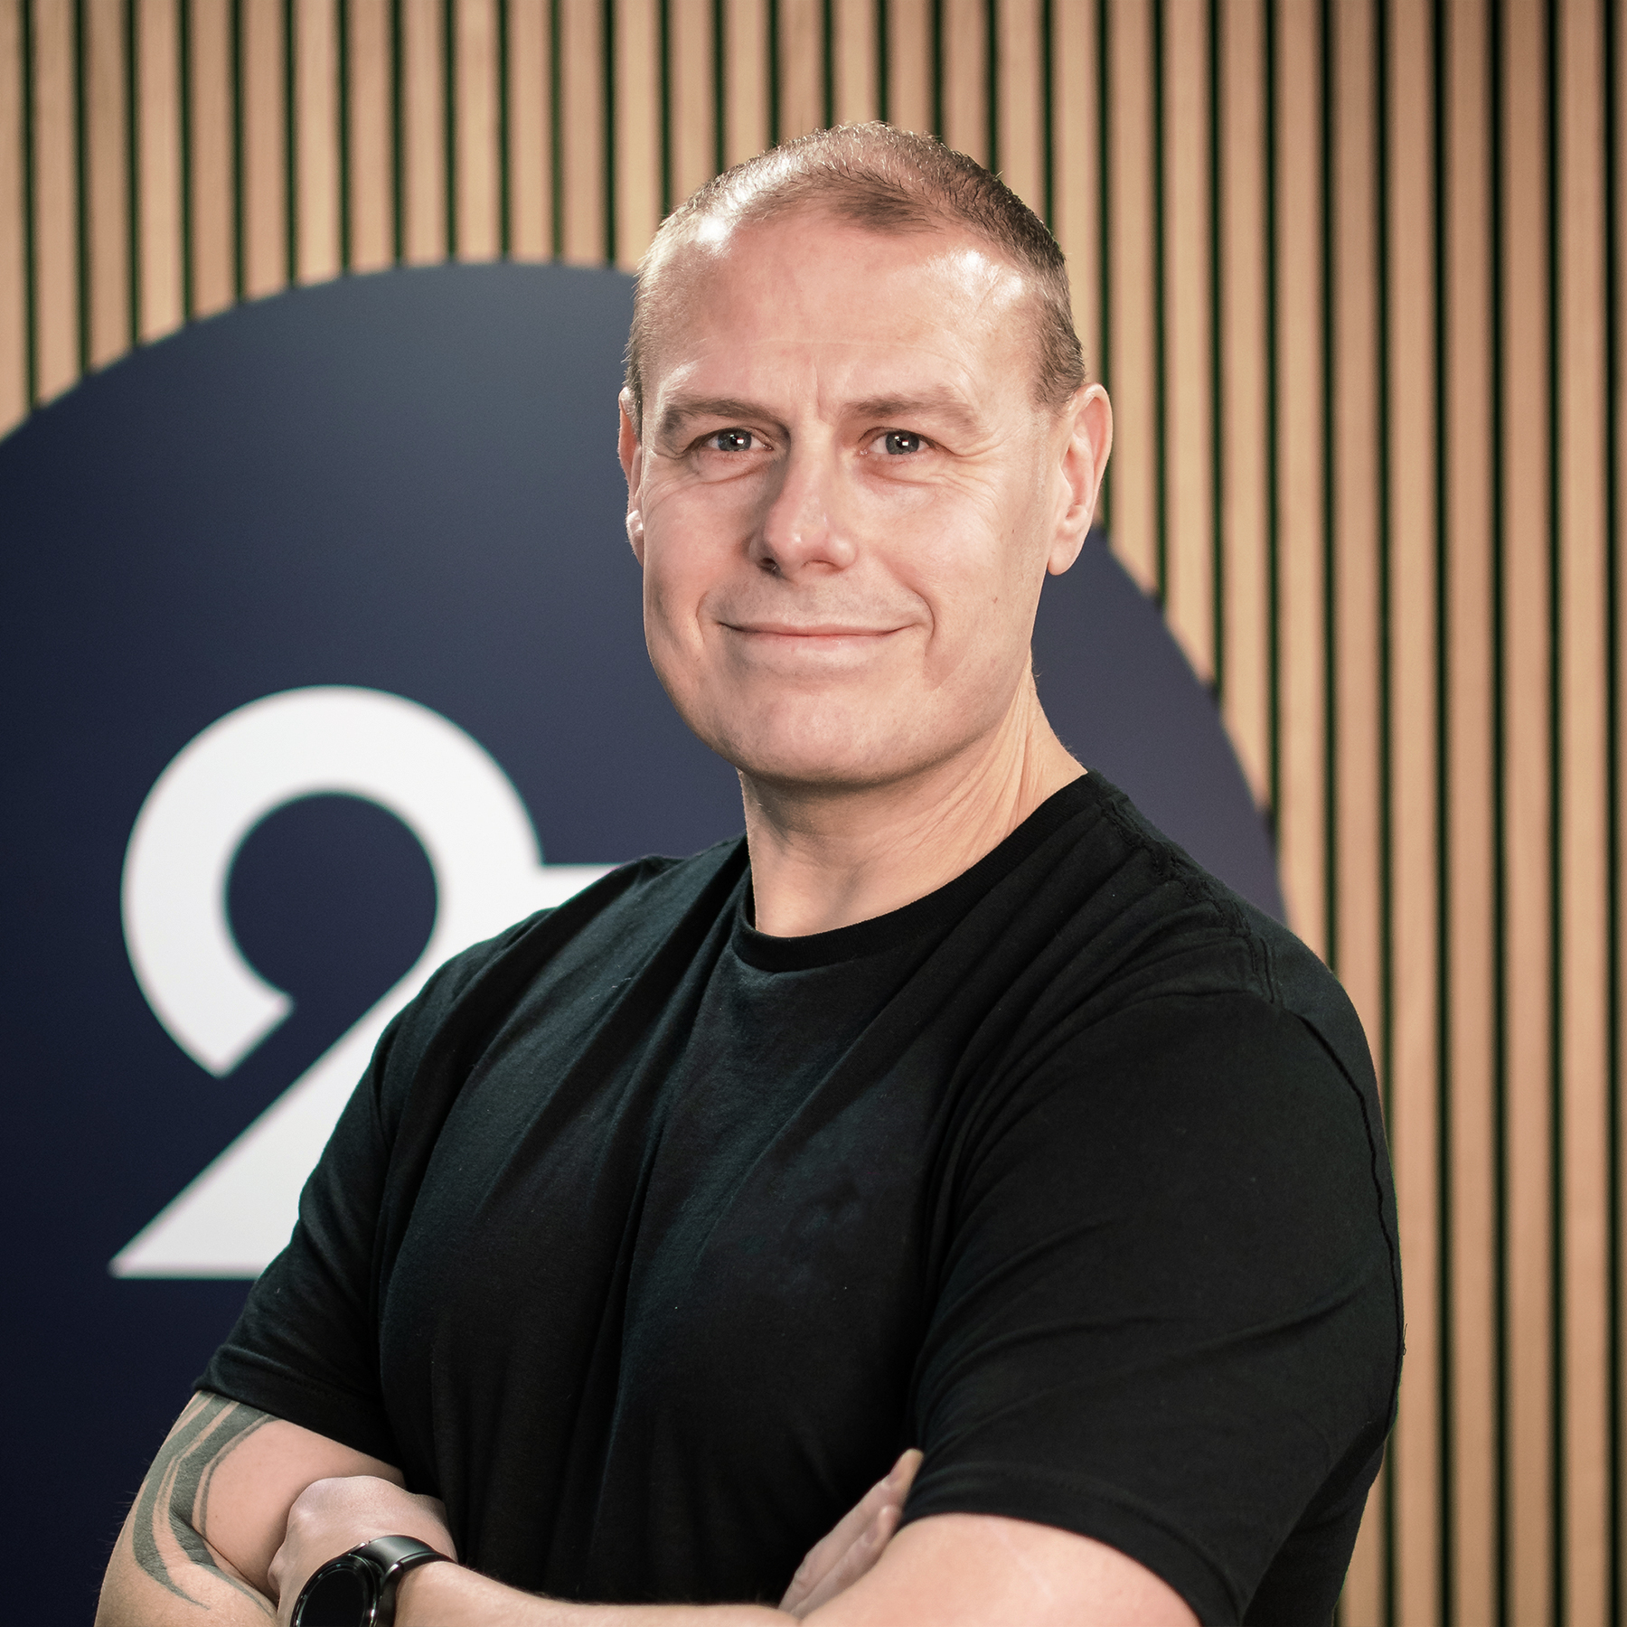

About me
Graham Carr
Lead .Net Developer
Email: graham.carr@26-dx.com
LinkedIn: https://www.linkedin.com/in/carrgraham/
Blog: https://world.optimizely.com/blogs/allthingsopti/
CMS Certifications:
Optimizely Content Cloud Developer
Umbraco Master
Sitecore Developer
Contentful Developer
Kontent.ai Developer

Slide 3
Agenda
01
What is Optimizely
02
Key features and benefits
03
Why I love working with Optimizely
04
Demonstration
05
Questions
Agenda

Slide 4
What is Optimizely?

Slide 5
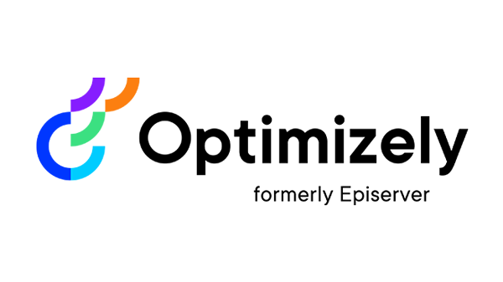
What is Optimizely?
Optimizely (formerly known as Episerver)
Digital Experience Platform
Enables companies to create, manage and optimise digital experiences across multiple channels, devices, and touchpoints.
Widely used by marketers, product managers and developers
Improve digital experiences
Increase conversions
Drive business growth

Slide 6
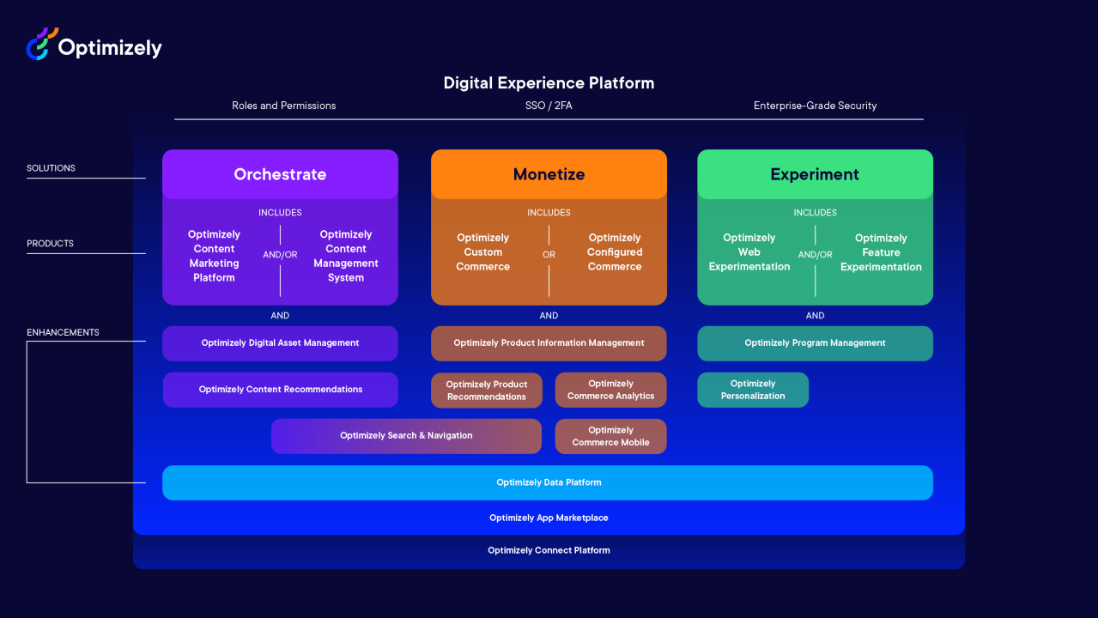
So, what’s the big deal?!?!

Slide 7
Key features and benefits

Slide 8
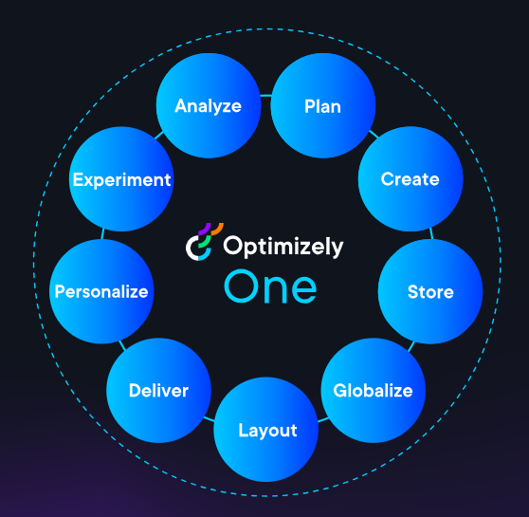
Key features and benefits
Content creation and management
Personalisation
A/B testing and experimentation
Multichannel Delivery
Workflow and collaboration
Extensibility and integrations
Scalability and performance
Notes:
Content creation and management: Optimizely provides a user-friendly interface for creating, editing, and managing content, including text, images, videos, and more.
Personalization: The platform allows marketers to deliver personalized content experiences based on user behavior, preferences, and demographics. A/B testing and experimentation: Optimizely enables users to run A/B tests and multivariate experiments to optimize content performance and user engagement. Multichannel delivery: Content can be easily published and distributed across various channels, ensuring a consistent experience for users. Workflow and collaboration: Optimizely supports streamlined content workflows and collaboration among team members, with features like version control, roles and permissions, and approval processes. Extensibility and integrations: The platform offers a range of extensions and integrations with third-party tools and services, allowing organizations to customize and enhance their content management capabilities.
Scalability and performance: Optimizely is designed to handle high traffic volumes and deliver fast, reliable experiences to users.

Slide 9
Why I love working with Optimizely

Slide 10



So, what’s the big deal?!?!

Slide 11
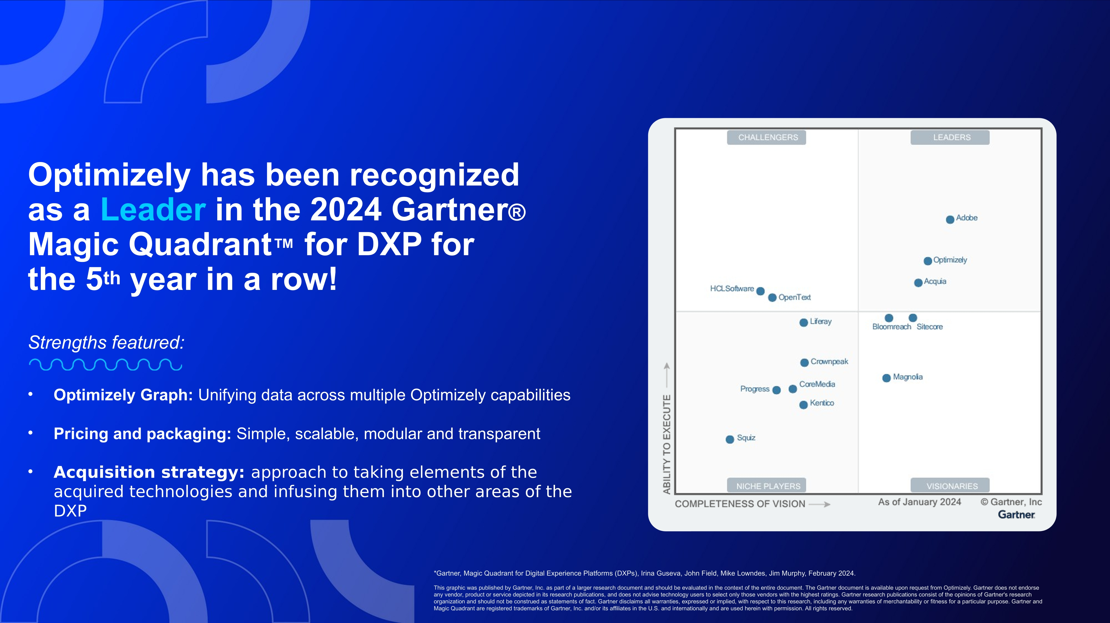
So, what’s the big deal?!?!

Slide 12

Why I love working with Optimizely
Developer friendly
Code first approach
Speed/Performance
CMS12 and .Net 8
PaaS and SaaS Core
Ease of use
Large and growing product suite
Extensive documentation
Extensive and helpful community
OMVP program
Partner access to beta products

Slide 13
Demonstration

Slide 14
Questions?

Slide 15
Thank you
Graham Carr
graham.carr@26-dx.com

